Slide 1


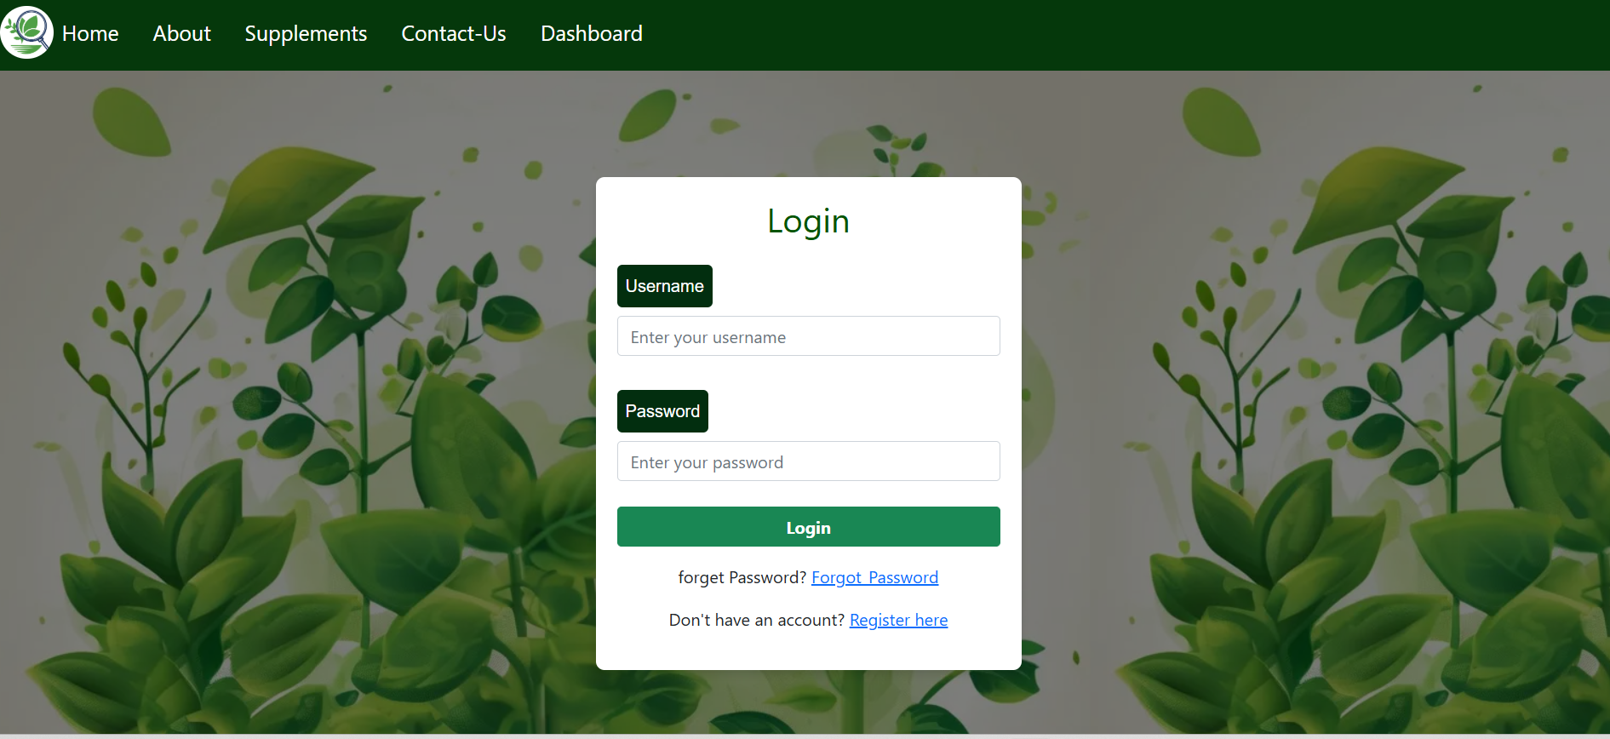
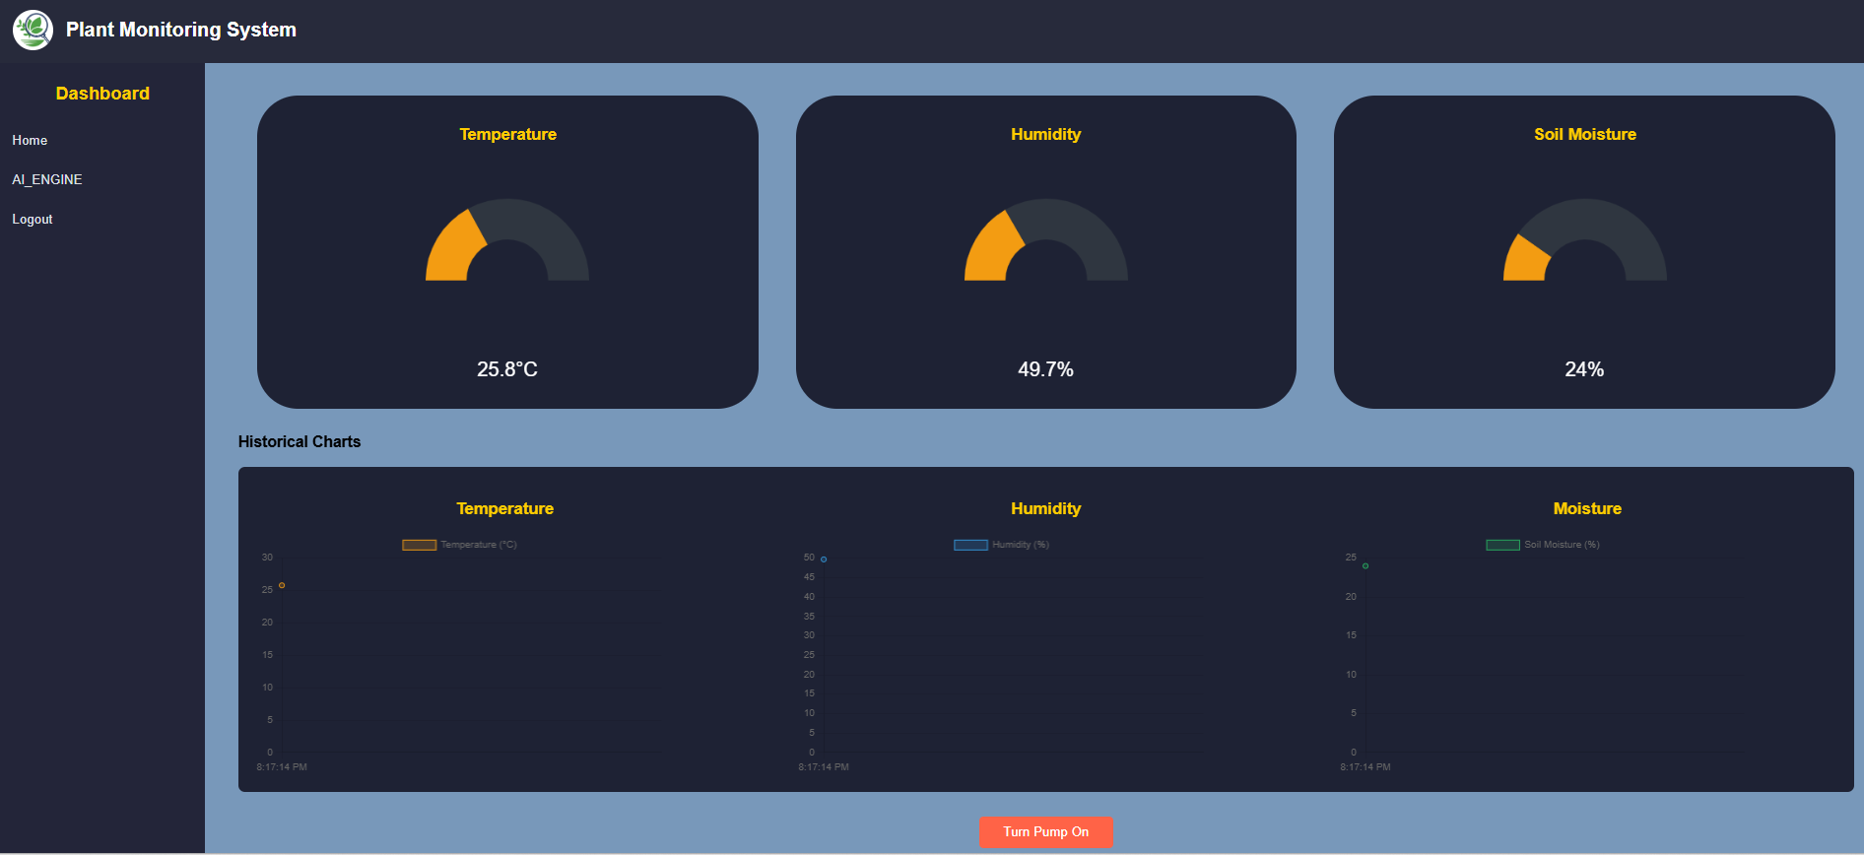
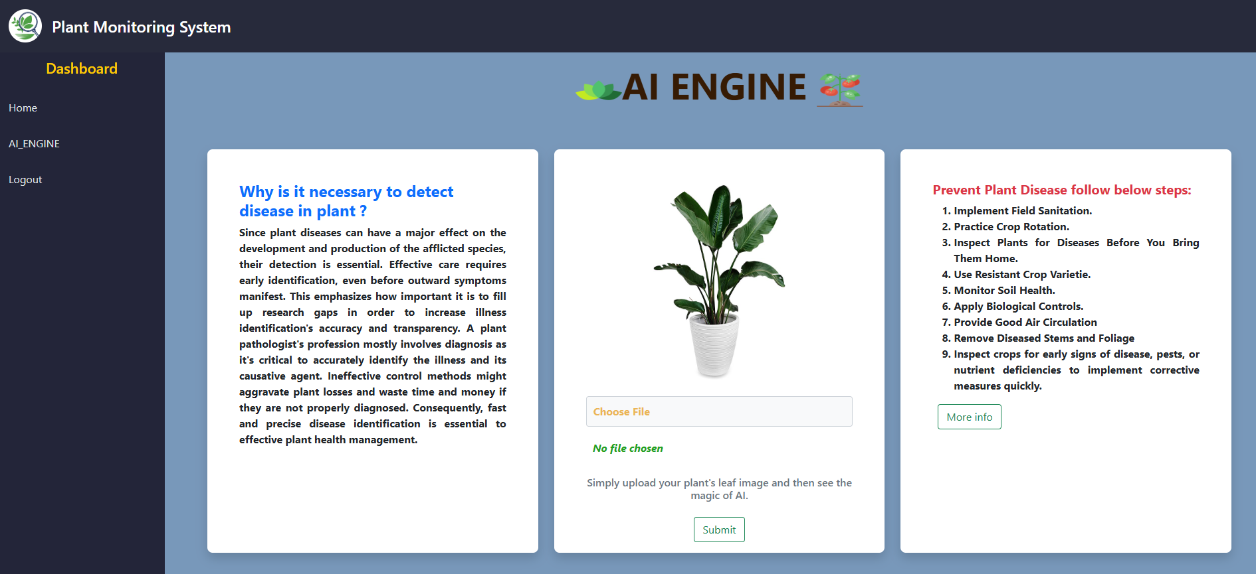

Karnatak Law Society’s GOGTE INSTITUTE OF TECHNOLOGY Belagavi
Project Expo-2024
Department of CSE
Project Title: Smart Plant Disease Detection and Field Monitoring System
Motivation and Objectives:
Enhance Disease Detection and Accuracy using ML and provide detailed supplementary information for identified diseases.
Boost Crop Health and Productivity.
Implement IoT sensors for comprehensive real-time field monitoring.
Create a user-friendly web interface with advanced AI features and visualization tools.
Methodology :
Web-Based Detection Interface
Implement Machine Learning Algorithms
Supplement information
Monitoring Dashboard
Results & Discussion :
Developed a system combining CNN for plant disease detection and IoT sensors for real-time field monitoring.
Delivered a user-friendly web interface with AI features, dashboards, and data visualization.
Achieved high accuracy in disease prediction and reliable sensor data integration.
Provided an efficient and scalable solution for smart agriculture.
Conclusions :
Effective Disease Detection
Comrehensice Filed Monitoring
User-Centric Interface
Remarks :
Project Group | Batch no. 46
Students | Irfan Hussain Lone 2GI22CS401 Rohan O Chikorde 2GI22CS409
Abhishek Shelke 2GI22CS400
Shubham Godse 2GI22CS413
Guide |
Dr. Prasad Pujar
2024-25

